Slide 1
OLIST Marketing and retail analytics
KRITHIGA K
DS-DA C37
​

Slide 2
AGENDA
Objective
Background
Data Cleaning & Exploration Summary
​Key Findings(Insights)
Recommendations
​​

Slide 3
OBJECTIVE
To identify top products that contribute to the revenue and also use market basket analysis to analyze the purchase behavior of individual customers to estimate with relative certainty, what items are more likely to be purchased individually or in combination with some other products.

Slide 4
BACKGROUND
OList is one such e-commerce company that has faced some losses recently and they want to manage their inventory very well so as to reduce any unnecessary costs that they might be bearing. In this assignment, you have to manage the inventory cost of this e-commerce company OList.

Slide 5
DATA CLEANING & EXPLORATION SUMMARY
We read each separate sheets from excel to python notebooks with the help of python libraries.
Orders:
No duplicate values.
Order with order_status as “Delivered” were filtered.
Missing values of timestamps were imputed as per the requirement.
No Outliers detected.
Order_Items:
No missing values.
No duplicate values.
Outlier treatment not done as may lead to data loss.
Customers:
No Missing values.
Duplicate customer Id’s were dropped.
No outliers detected.
Payments:
No Missing values.
Duplicate Order Id’s were dropped.
Outliers treatment not done as may lead to data loss.
Products:
Missing values for product category name imputed with Mode and product_weight_g, product_length_cm, product_height_cm, product_width_cm with mean values .
No duplicate values.
After the complete treatment the cleaned data was exported to ‘Cleaned_Retail_Data’ excel file with the sheet names remaining the same.

Slide 6
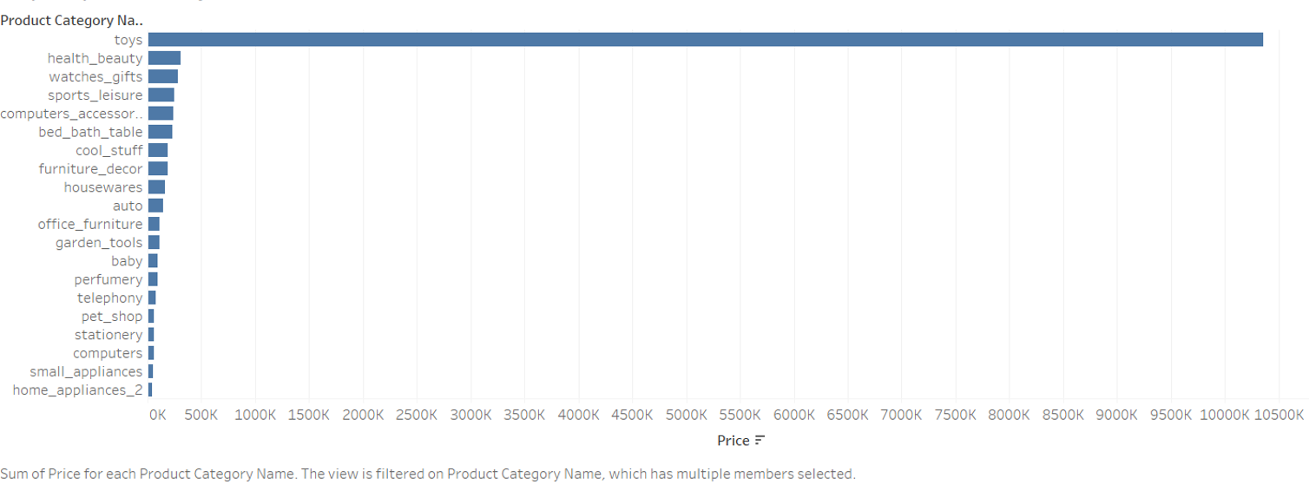
Top 20 products by revenue
The highest revenue generated is 10,360,560, which belongs to Toys category.

Slide 7
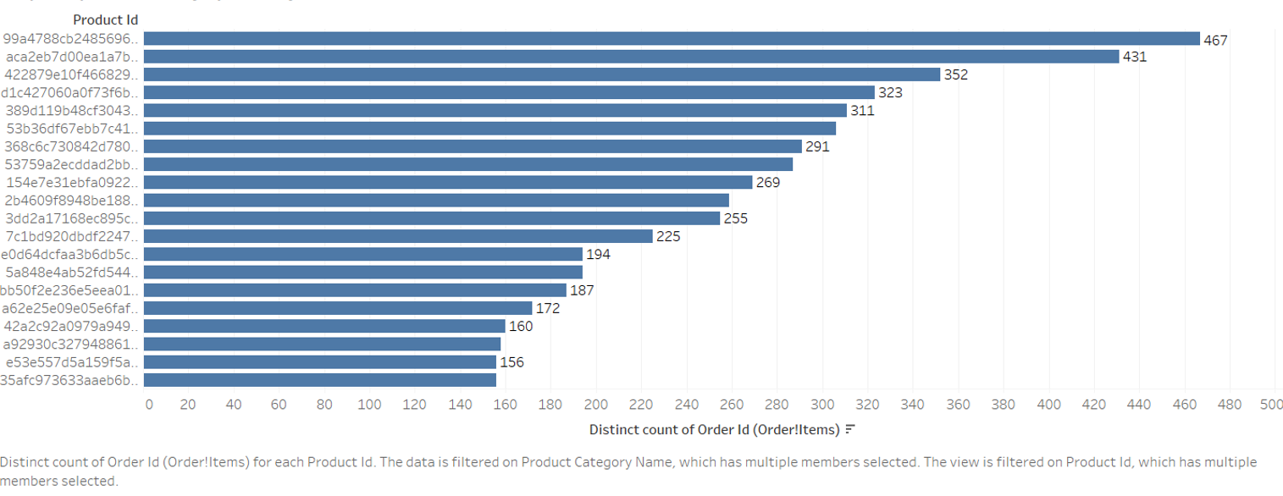
Top 20 products by quantity
The highest ordered product 99a4788cb24856965c36a24e339b6058 belongs to Toys category and it has been ordered for 467 times.

Slide 8
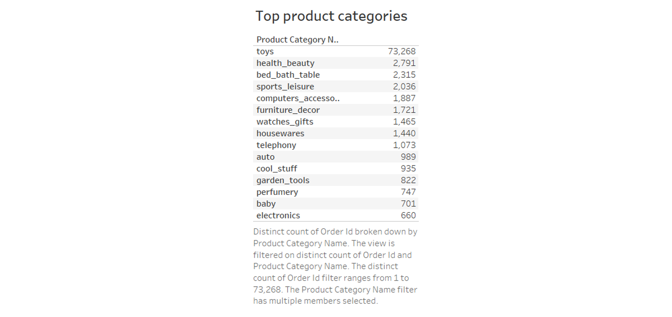
Top product categories

Slide 9
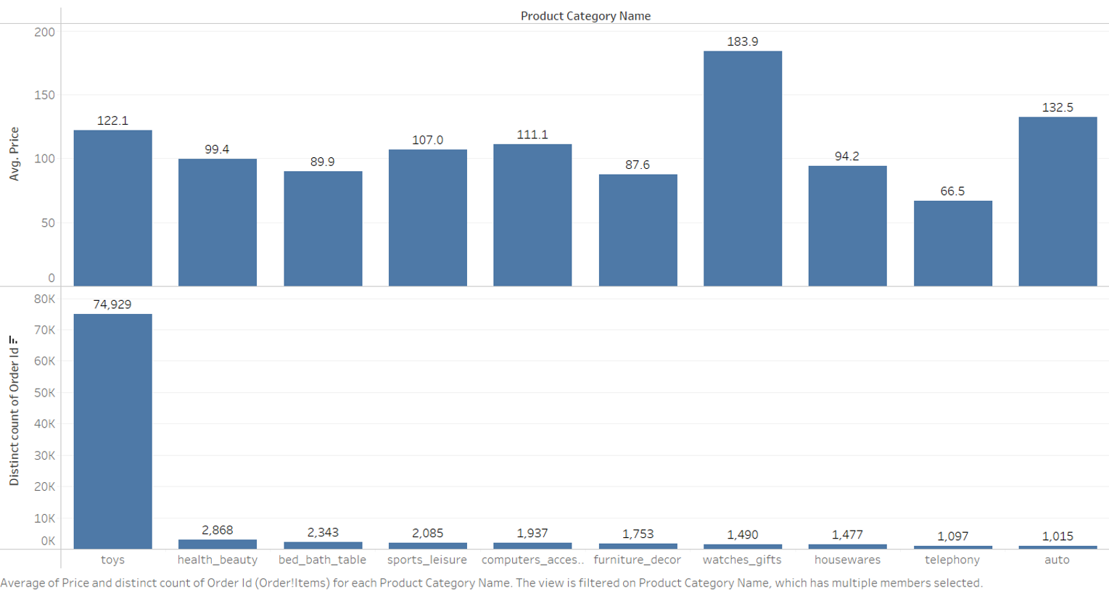
(Avg. price vs count of orders) for product categories
The category watches_gifts having the highest average price of 183.9, followed by auto(132.5) and toys(122.1)

Slide 10
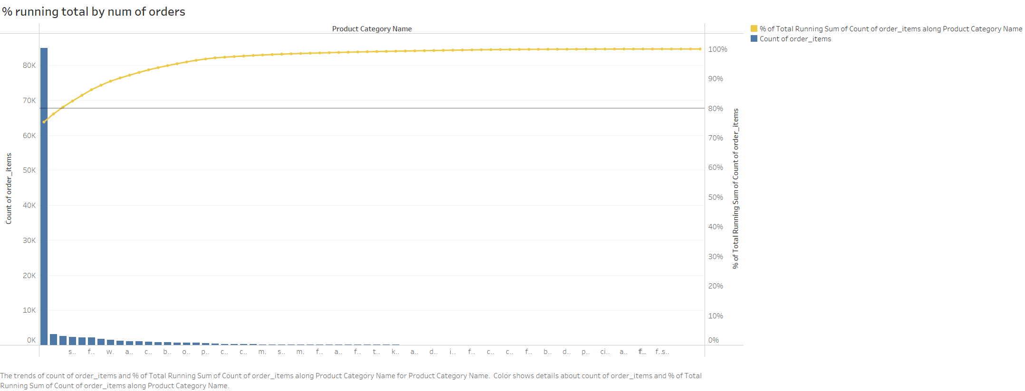
% running total by no. of orders
Toys, health_beauty and bed_bath_table contribute the 80.38% and the rest contributes 19.62% of total orders according to the Pareto Analysis.

Slide 11
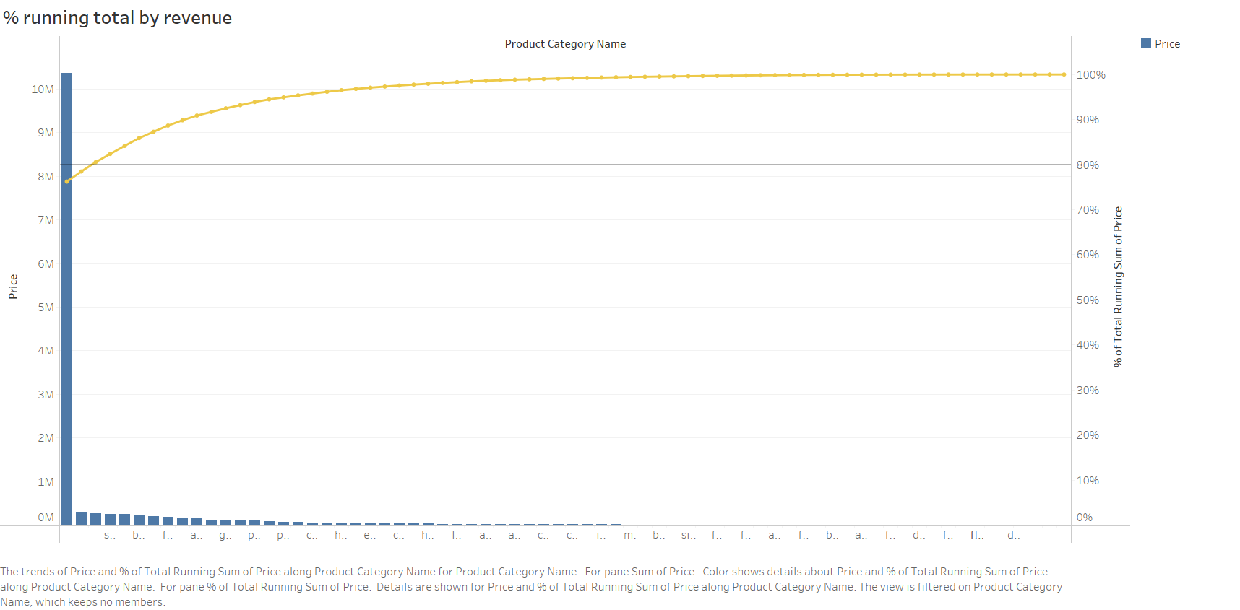
% running total by revenue
Toys, health_beauty and watches_gifts contribute the 80.56% and the rest contributes 19.44% of total revenue according to the Pareto Analysis.

Slide 12
Market basket analysis
Apriori Algorithm & Association Rule
Apriori algorithms is a data mining algorithm used for mining frequent itemsets and relevant association rules. It is devised to operate on a database that contain transactions -like, items bought by a customer in a store.
An itemset can be considered frequent if it meets a user-specified support threshold. For example, if the support threshold is set to 0.5(50%), a frequent itemset is a set of items that are bought/purchased together in atleast 50% of all transactions.
Association rules are a set of rules derived from a database, that can help determining relationship among variables in a large transactional database.

Slide 13
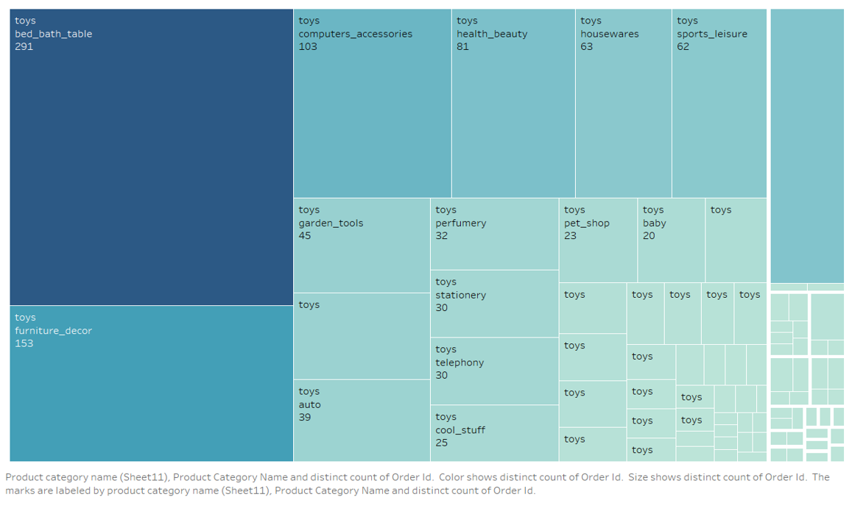
MARKET BASKET ANALYSIS IN TABLEAU
As we can see, Toys are sold really well with bed_bath_table, furniture_decor and computers_accessories.

Slide 14
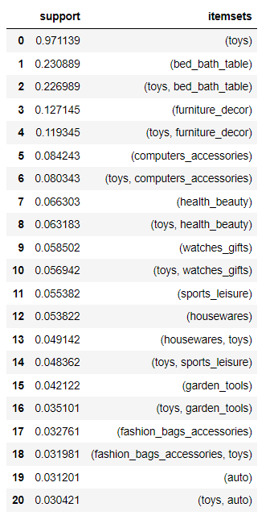
MARKET BASKET ANALYSIS IN PYTHON
Generating frequent itemsets from a list of items
First step in generation of association rules is to get all the frequent itemsets. Frequent itemsets are the ones which occur at least a minimum number of times in the transactions.
Support
This says how popular an itemset is, as measured by the proportion of transactions in which an itemset appears
If you discover that sales of items beyond a certain proportion tend to have a significant impact on your profits, you might consider using that proportion as your support threshold. You may then identify itemsets with support values above this threshold as significant itemsets
Confidence
This says how likely item Y is purchased when item X is purchased, expressed as {X -> Y}. This is measured by the proportion of transactions with item X, in which item Y also appears
One drawback of the confidence measure is that it might misrepresent the importance of an association. This is because it only accounts for how popular apples are, but not beers. If beers are also very popular in general, there will be a higher chance that a transaction containing apples will also contain beers, thus inflating the confidence measure. To account for the base popularity of both constituent items, we use a third measure called lift.
Confidence(x-->Y) = Support(X,Y)/Support(X)
Lift
This says how likely item Y is purchased when item X is purchased, while controlling for how popular item Y is. In Table 1, the lift of {apple -> beer} is 1,which implies no association between items. A lift value greater than 1 means that item Y is likely to be bought if item X is bought, while a value less than 1 means that item Y is unlikely to be bought if item X is bought
Lift (X-->Y) = Support(X,Y)/Support(X)*Support(Y)

Slide 15
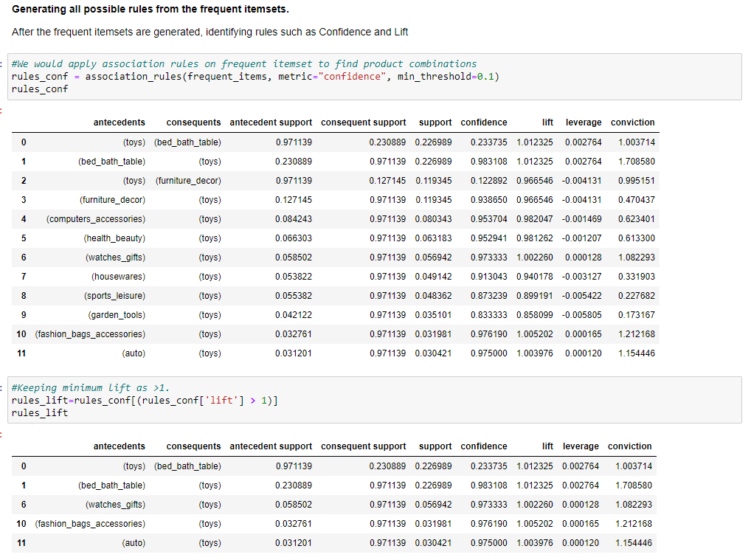
Top products categories in groups of two’s are:
Toys and Bed Bath Table
Toys and Fashion Bags Accessories
Toys and Auto
Toys and Watches Gift

Slide 16
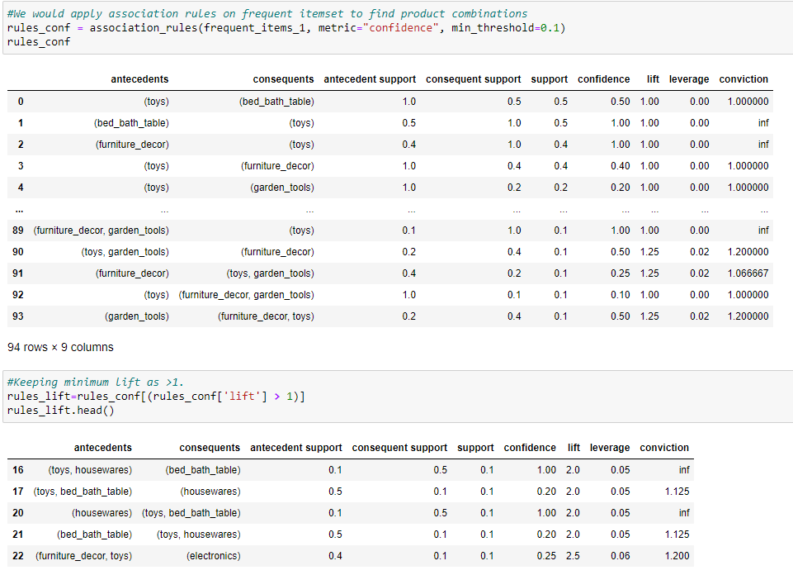
Top products categories in groups of three’s are:
1. Toys, Bed bath table and Housewares
2. Toys, Bed bath table and Office furniture
3. Toys, Garden Tools and Computer Accessories
4. Toys, Furniture Decor and Electronics
5. Toys, Bed bath table and Health and Beauty

Slide 17
RECOMMENDATIONS
Toys should always be in stock as it is contributing to the good amount of revenue.
Only the categories that generate more than 80% of revenue should be focused.
Old stocks which generate less revenue can be removed from the warehouse.
OList can provide coupon codes or gift vouchers or even may discount one of their product combinations to encourage people to buy.

Slide 18
THANK YOU
KRITHIGA K
DS-DA C37

